Slide 1
Medical Chatbot
Capstone project 3
Ni Qie

Slide 2
CONTENTS
Overview
01
Structure
02
Agent
03
Neo4j Database
04
Chatbot Interface
05

Slide 3
Overview - a chatbot that answers medical or disease related questions
User Input
Receives messages or questions about diseases, symptoms, medications, and other health topics.
Information Retrieval
Utilizes multiple sources such as local files (PDFs, TXT, CSV) containing medical literature.
Employs knowledge graphs like Neo4j to store relationships between medical concepts.
Conducts Google searches to access information from reputable medical websites.
Disease-related Questions
Answers queries like "What causes a cold?" or "What are the symptoms of diabetes?"
Retrieves and presents summaries of relevant information.
Medication Information
Provides information on medications for specific conditions, e.g., "What medicines should I take for a cold?"
Details recommended dosages, potential side effects, and other relevant medication information.
Generic Conversations
Engages in general health discussions, responds to greetings, provides health tips, and manages small talk for a conversational experience.
Summarization
Uses natural language processing to summarize retrieved information, ensuring clear and concise responses to user queries.

Slide 4
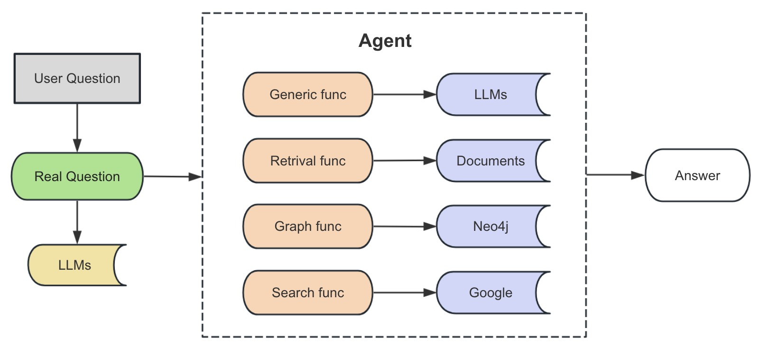
Structure

Slide 5
Agent
retrieves relevant fragments from documents to answer medical questions
retrieving information from Google when other tools are unable to provide answers.
01
03
Agent Generic
Agent Retrieval
Agent Graph
Agent Search
leverages the capabilities of a large model to answer general everyday communication questions.
retrieves data from a knowledge graph to answer disease-related questions,
02
04

Slide 6
Python script and its functionalities
Agent.py
Imports: Utilizes modules such as utils, config, prompt, os, langchain, py2neo, neo4j, and translate.
Agent Class Functionalities:
Initialization: Utilizes tools for user query responses across various domains.
Data Handling: Employs Chroma and FAISS vector stores for search and queries.
Translation: Automatically translates user inputs to Chinese.
Response Generation: Uses a language model chain for generating answers.
Database Interaction: Retrieves data from a Neo4j graph database.
Memory Management: Implements functionality to store conversation history.
App.py
Gradio UI Setup:
Imports: Utilizes the gradio library for UI development.
Doctor Bot Function: Defines callback for handling user interactions.
Styling: Manages custom CSS for UI aesthetics.
Chat Interface: Configures chat features, including example queries and management buttons.
Launch: Initiates the interface for user interaction.
Config.py
Query Template Definitions:
Defines templates for medical graph queries such as disease description, symptoms, treatments, and more.
Each template includes slots for dynamic data and structured responses for user queries.

Slide 7
Data_process.py
Document Processing Tasks:
Setup: Imports necessary libraries and defines the document-to-vector conversion function.
Text Handling: Implements text splitting for document segmentation.
File Handling: Iterates over documents for processing.
Vectorization: Converts text segments to vectors and stores them using the Chroma vector store.
Prompt.py
Template Management:
Defines multiple prompt templates for different conversational AI tasks such as retrieval, summarization, and named entity recognition.
Service.py
Service Class Functionalities:
Initialization: Sets up an agent for query response.
Summary Generation: Produces summaries based on conversation history.
Query Handling: Manages user queries and generates responses.
Utils.py
Utility Functions:
Provides essential functionalities such as model retrieval, token replacement in strings, and database connections.
Supports structured output parsing for conversational responses.

Slide 8
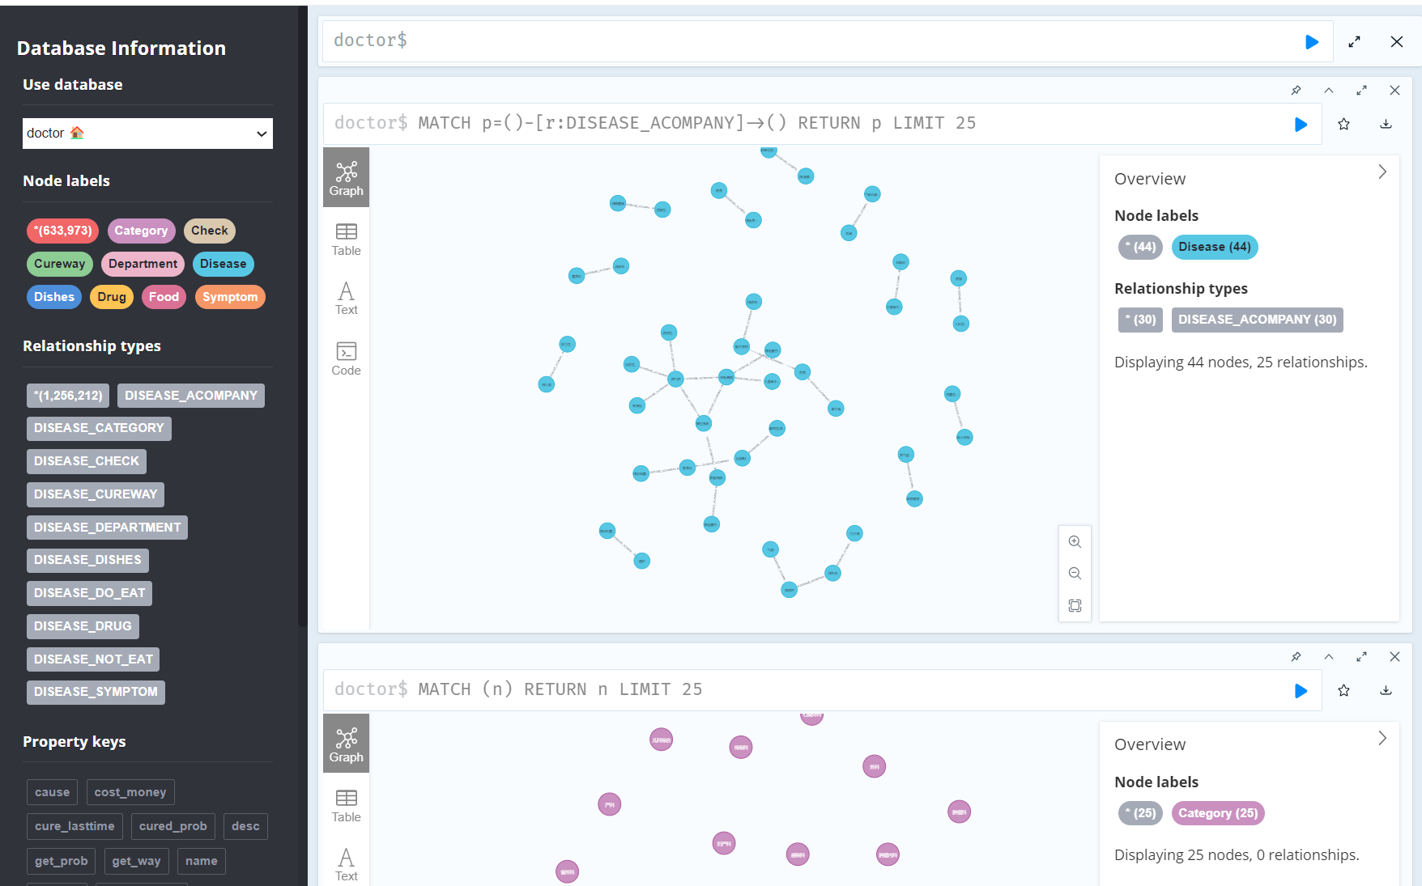
Neo4j Database

Slide 9
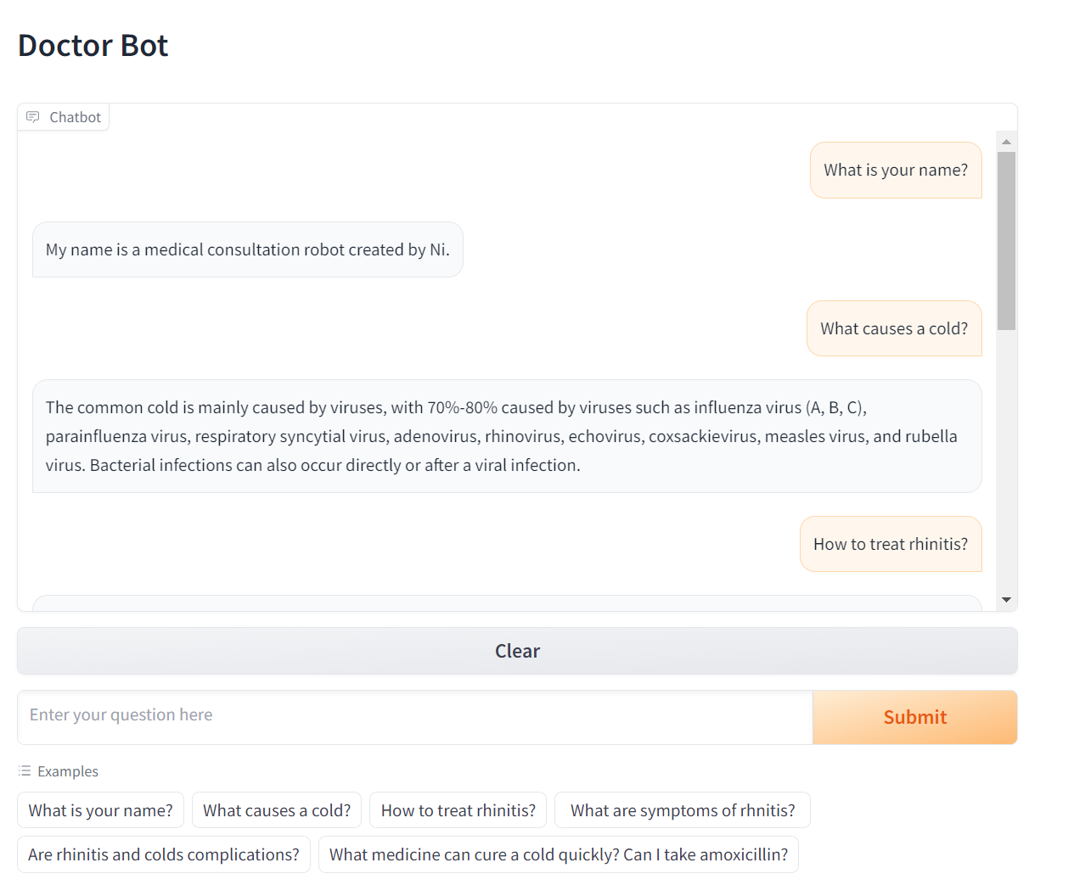
Interface-demo

Slide 10
Thanks.

